Slide 1
Heap
Course Code: CSC 2106
Course Title: Data Structure (Theory)
Dept. of Computer Science
Faculty of Science and Technology
Lecture No: | 11.1 | Week No: | 11 | Semester:
Lecturer: | Jannatul Maowa Email: maowa@aiub.edu

Slide 2
Lecture Outline
Insertion-Putting An Element Into A Max Heap
Deletion-Removing The Max / Min Element
HeapSort
Uses of Heapsm
Complexity of Heaps
Some Important Properties of a Heapmportant Properties of a Heap

Slide 3
Insertion-Putting An Element Into A Max Heap
Complete binary tree with 9 nodes.
9
8
7
6
7
2
6
5
1
7
5
If the New element is 5, then its okay.

Slide 4
Insertion-Putting An Element Into A Max Heap
Complete binary tree with 9 nodes.
9
8
7
6
7
2
6
5
1
7
20
If the new element is 20 rather than 5, then we need to find home for 20.

Slide 5
Insertion-Putting An Element Into A Max Heap
9
8
7
6
20
2
6
5
1
7
Find home for 20
7
7

Slide 6
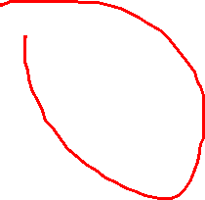
Insertion-Putting An Element Into A Max Heap
9
20
7
6
8
2
6
5
1
7
Find home for 20
7
7

Slide 7
Insertion-Putting An Element Into A Max Heap
20
9
7
6
8
2
6
5
1
7
7
7
Done. Max element is in the root.

Slide 8
Deletion-Removing The Max / Min Element
Removal of root: The procedure for deleting the root from the heap (effectively extracting the max/min element in a max-heap or in a min-heap) and restoring the properties is called down-heap (also known as heapify-down, cascade-down and extract-min/max).
Delete
Replace/exchange the root of the heap with the last element on the last level.
Reduce the heap size by one and
Perform the MAX-HEAPIFY(A, 0, n-1 ) function for the root i=0.

Slide 9
Deletion-Removing The Max Element
Complete binary tree with 11 nodes.
20
15
7
6
9
2
6
5
1
7
8
7
8
7
Max element is in the root.

Slide 10
Deletion-Removing The Max Element
After max element is removed.
We will have Complete binary tree with 10 nodes.
20
15
7
6
9
2
6
5
1
7
8
7
8
7
Exchange last element 8 with the root 20 into the heap.

Slide 11
Deletion-Removing The Max Element
After max element is removed.
We will have Complete binary tree with 10 nodes.
8
15
7
6
9
2
6
5
1
7
20
7
8
7
Exchange last element 8 with the root 20 into the heap.

Slide 12
Deletion-Removing The Max Element
8
15
7
6
9
2
6
5
1
7
20
7
7
Reduce the heap size by one and we have Complete binary tree with 10 nodes.
Find home for 8

Slide 13
Deletion-Removing The Max Element
15
8
7
6
9
2
6
5
1
7
7
7
Find home for 8

Slide 14
Deletion-Removing The Max Element
15
9
7
6
8
2
6
5
1
7
7
7
Done . Complete binary tree with 10 nodes.
Max element is in root.

Slide 15
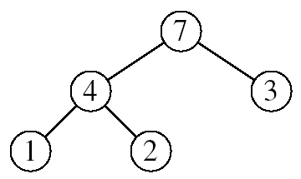
Heapsort
Goal:
Sort an array using heap representations
Idea:
Build a max-heap from the array
Swap the root (the maximum element) with the last element in the array
“Discard” this last node by decreasing the heap size
Call MAX-HEAPIFY on the new root
Repeat this process until only one node remains

Slide 16
Alg: HEAPSORT(A)
BUILD-MAX-HEAP(A) ……………….
for i ← n-1 down to 1
do exchange A[0] ↔ A[i]
MAX-HEAPIFY(A, 0, i) ….
Running time: O(nlogn)
O(n)
n-1 times
O(logn)

Slide 17

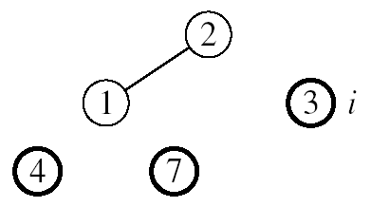
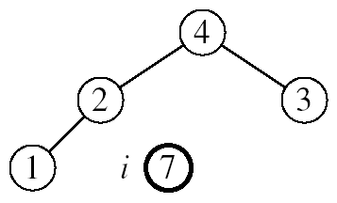
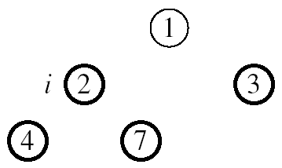
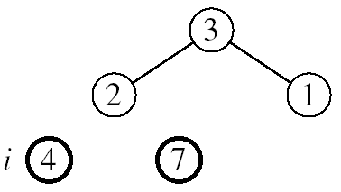
HEAPSORT Example
Input Array, A=[7, 4, 3, 1, 2]
MAX-HEAPIFY(A, 0, 4)
MAX-HEAPIFY(A, 0, 3)
MAX-HEAPIFY(A, 0, 2)
Output Array/ Sorted Array
MAX-HEAPIFY(A, 0, 1)

Slide 18
Uses of Heaps
There are two main uses of heaps.
The first is as a way of implementing a special kind of queue, called a priority queue.
The second application is sorting.

Slide 19
Complexity of Heaps
To sort an array, or list, containing N values there are two steps:
insert each value into a heap (initially empty)
remove each value form the heap in ascending order (this is done by N successive calls to get smallest).
What is the complexity of the Heapsort algorithm?
(N insert operations) + (N delete operations)
Each insert and delete operation is O(logN) at the very worst - the heap does not always have all N values in it.
So, the complexity is certainly no greater than O(NlogN).

Slide 20
Some Important Properties of a Heap
Given n, there exists a unique binary tree with n nodes that is essentially complete, with
h = ⎣log₂ n⎦
The root contains the largest key
The subtree rooted at any node of a heap is also a heap
A heap can be represented as an array
A Heap is a data structure used to efficiently find the smallest (or largest) element in a set.
Min-heaps make it easy to find the smallest element.
Max-heaps make it easy to find the largest element.

Slide 21
Some Important Properties of a Heap
Heaps are based upon trees. These trees maintain the heap property.
The Heap invariant. The value of Every Child is greater than the value of the parent. We are describing Min-heaps here (Use less than for Max-heaps).
The trees must be mostly balanced for the costs listed below to hold.
Access to elements of a heap usually have the following costs.
The cost to find the smallest (largest) element takes constant time.
The cost to delete the smallest (largets) element takes time proportional to the log of the number of elements in the set.
The cost to add a new element takes time proportional to the log of the number of elements in the set.

Slide 22
Some Important Properties of a Heap
Heaps can be implemented using arrays (using the tree embedding described above) or by using balanced binary trees
Trees with the leftist property have the following invariant.
The leftist invariant. The rank of every left-child is equal to or greater than the rank of the cooresponding right-child. The rank of a tree is the length of the right-most path.
Heaps form the basis for an efficient sort called heap sort that has cost proportional to n*log(n) where n is the number of elements to be sorted.
Heaps are the data structure most often used to implement priority queues.

Slide 23
Books
“Schaum's Outline of Data Structures with C++”. By John R. Hubbard (Can be found in university Library)
“Data Structures and Program Design”, Robert L. Kruse, 3rd Edition, 1996.
“Data structures, algorithms and performance”, D. Wood, Addison-Wesley, 1993
“Advanced Data Structures”, Peter Brass, Cambridge University Press, 2008
“Data Structures and Algorithm Analysis”, Edition 3.2 (C++ Version), Clifford A. Shaffer, Virginia Tech, Blacksburg, VA 24061 January 2, 2012
“C++ Data Structures”, Nell Dale and David Teague, Jones and Bartlett Publishers, 2001.
“Data Structures and Algorithms with Object-Oriented Design Patterns in C++”, Bruno R. Preiss,

Slide 24
References
https://en.wikipedia.org/wiki/Data_structure

